Slide 1
Chapter 3: Operational Amplifiers
Module 1 : Basics of OpAmp
Reference: Robert L. Boylestad, Louis Nashelsky, Electronic Devices & Circuits Theory, 11th Edition, PHI, 2012

Slide 2
Objectives
Draw the block diagram of an OPAMP and briefly describe the functions.
List and define key parameters of an OPAMP.
Discuss OPAMP based amplifier topologies.
Design OPAMP based circuits for simple mathematical operations.

Slide 3
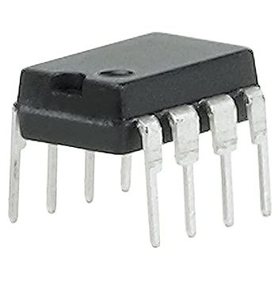
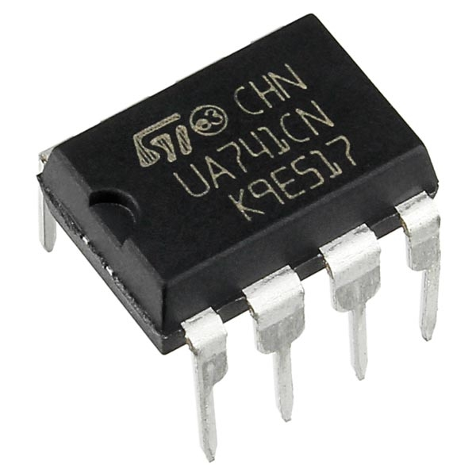
An OpAmp is a very high gain direct coupled amplifier which can amplify signals over a wide range of frequencies.
Used to perform various operations on signals such as addition, subtraction, multiplication along with amplification. Hence the name

Slide 4
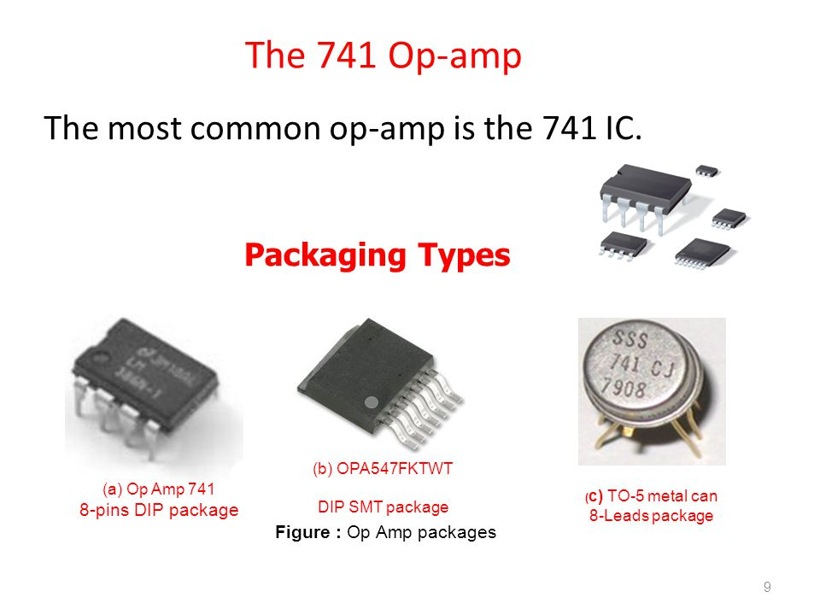

Slide 5
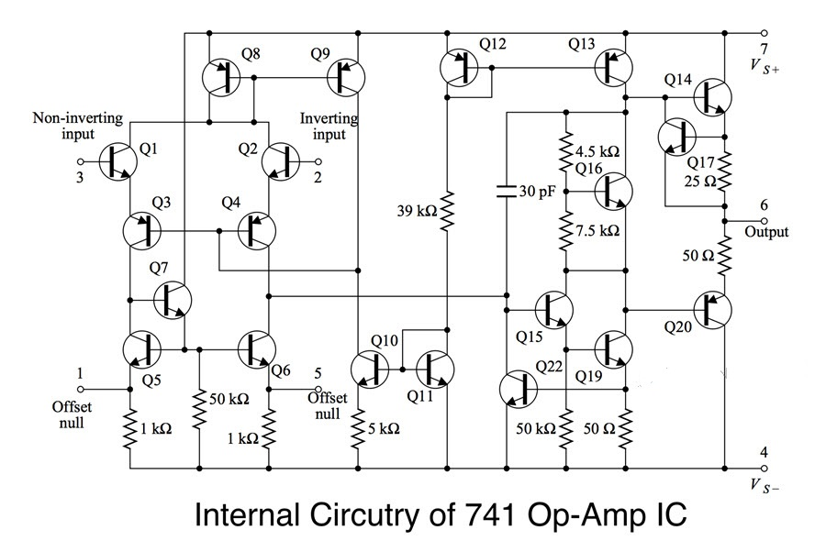

Slide 6
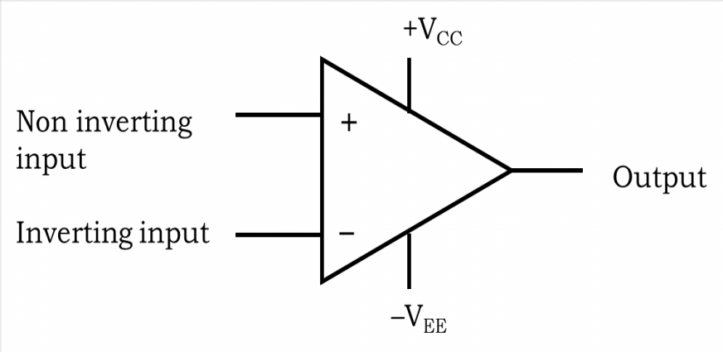
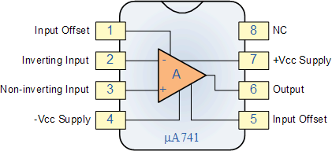
Symbol of OpAmp
Pin detail of µA741 IC

Slide 7
Open loop configuration
OpAmp is a differential amplifier
Amplifies difference between voltage at
Non-inverting pin and Inverting pin.
V_{out}= A_{d}(V₁-V₂)
V_{out}= A_{d}(V_{id})
Where,
A_{d} = Differential Gain
V₁ = Voltage at Non inverting terminal
V₂ = Voltage at Inverting terminal

Slide 8
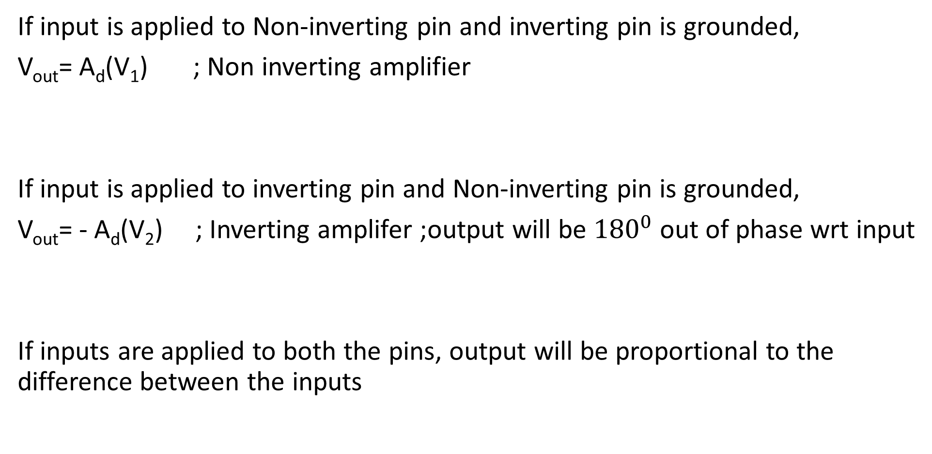
If input is applied to Non-inverting pin and inverting pin is grounded,
V_{out}= A_{d}(V₁) ; Non inverting amplifier
If input is applied to inverting pin and Non-inverting pin is grounded,
V_{out}= - A_{d}(V₂) ; Inverting amplifer ;output will be ${180}^{0}$ out of phase wrt input
If inputs are applied to both the pins, output will be proportional to the difference between the inputs

Slide 9

If V₁=V₂ , V_{out} =???
V_{out}= A_{CM} ($\frac{V1+V2}{2}$)
A_{CM} = Common mode gain; ability of OpAmp to amplify signal common to both pins(noise)
Overall
V_{out}= A_{d}(V₁-V₂)+ A_{CM} ($\frac{V1+V2}{2}$)

Slide 10
Differential Signal – To be amplified; Infinite A_{d}
Noise Signal – To be suppressed; least A_{CM}
Common Mode Rejection Ratio=(A_{d} / A_{CM})
In decibels; CMRR= 20log(A_{d} / A_{CM})
Ideally CMRR= ∞

Slide 11
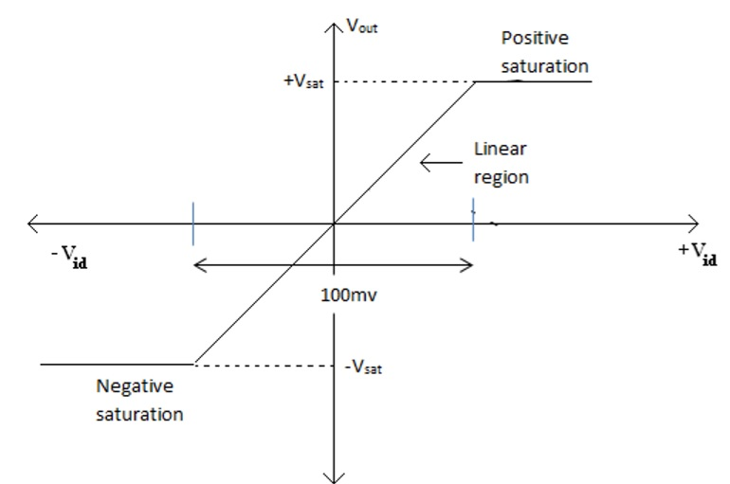
Ideal Voltage Transfer Characteristics

Slide 12
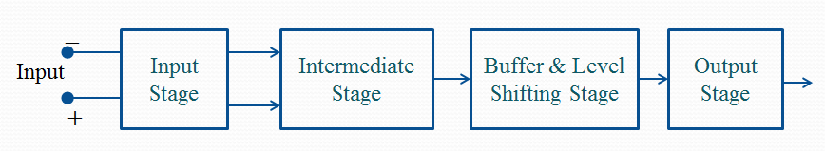
Block Diagram of an OpAmp

Slide 13
Input stage:
Function is to amplify the difference between the two input signals.
Provides high differential gain
Intermediate stage:
Input stage alone cannot provide high gain, an intermediate stage is used to provide the required additional voltage gain
Buffer and Level shifting stage:
Level shifting stage is used to eliminate the dc level. Buffer is a unity voltage gain amplifier usually used for impedance matching.
Output stage:
Contributes to the overall gain of the op-amp and also provides low output impedance.

Slide 14
Characteristics of OpAmp
1.Differential mode gain A_{d}
Factor by which difference between the input signals is amplified by the OpAmp
2.Common mode gain A_{CM}
Factor by which common mode input voltage is amplified by the OpAmp
3.Common mode rejection ratio (CMRR)
Measure of ability of OpAmp to reject the signal common to both the input pins (noise)

Slide 15
4.Input Resistance(R_{i})
Equivalent resistance measured between the 2 input terminals of the OpAmp
5.Output Resistance(R_{o})
Resistance measured at output pin with respect to ground
6.Bandwidth
Range of frequencies over which gain is constant

Slide 16
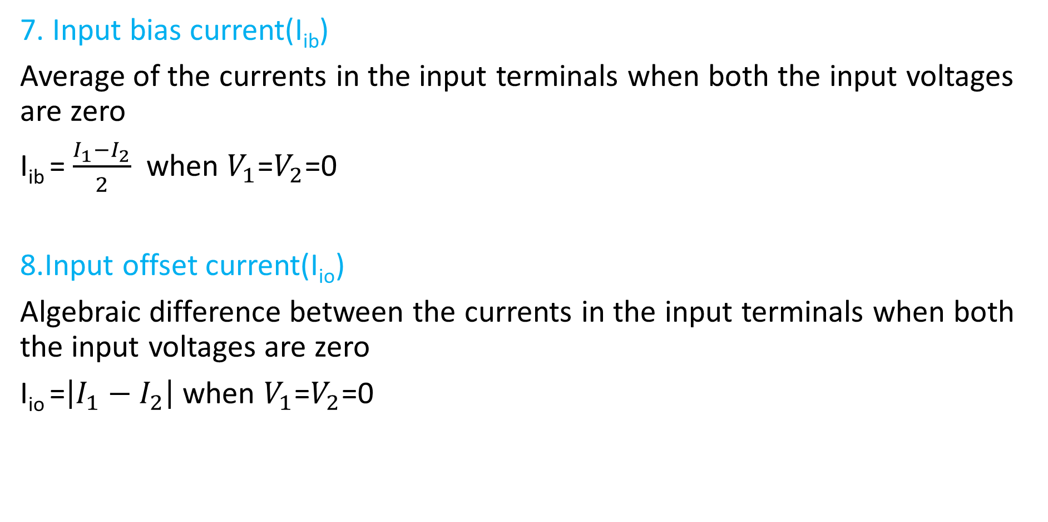
7. Input bias current(I_{ib})
Average of the currents in the input terminals when both the input voltages are zero
I_{ib} = $\frac{I_{1}−I_{2}}{2}$ when $V_{1}$=$V_{2}$=0
8.Input offset current(I_{io})
Algebraic difference between the currents in the input terminals when both the input voltages are zero
I_{io} =$\left|I_{1}−I_{2}\right|$ when $V_{1}$=$V_{2}$=0

Slide 17
9.Input offset voltage(V_{io})
The differential voltage that must be applied at the input terminals inorder to make the output voltage zero
10.Output offset voltage(V_{oo})
Output voltage when both input voltages are zero. This is due to input offset voltage
11. Slew rate
Maximum rate of change of output with respect to time. Slew rate has to be very high if the OpAmp has to operate at high frequencies

Slide 18
Ideal and Practical Op-Amp characteristic values
 | Characteristics | Ideal | Practical
1 | Band width | ∞ | 1MHz
2 | Input resistance, R_{i} | ∞ | 2MΩ
3 | Output resistance. R_{o} | zero | 75Ω
4 | CMRR | ∞ | 90dB
5 | Slew rate | high | 0.5 V/μs
6 | Input offset voltage | 0 | 6mv (max)
7 | Input offset current | 0 | 200 nA (max)
8 | Differential mode output voltage gain A_{d} | ∞ | 50000
9 | Common mode output voltage gain A_{c} | 0 | 10

Slide 19

Q1. An OpAmp has $A_{d}$ of 99999 and common mode rejection ratio of 55dB.If non inverting voltage is 250µV, and inverting voltage is 240µV, calculate the output voltage of the OpAmp.

Slide 20

Q2. For an OpAmp when $V_{1}$=0.5mV and$V_{2}$= -0.5mV,output is 8V. For the same OpAmp when $V_{1}$=$V_{2}$=1mV, output is 12mV. Calculate the CMRR of the device.

Slide 21

Q3.For an OpAmp $A_{d}$=${10}^{5}$, CMRR=60dB. If non inverting voltage is 150µV and inverting voltage is 140µV, calculate the output voltage.

Slide 22
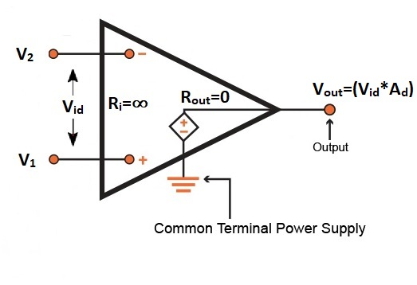
Ideal OpAmp - Equivalent Circuit

Slide 23
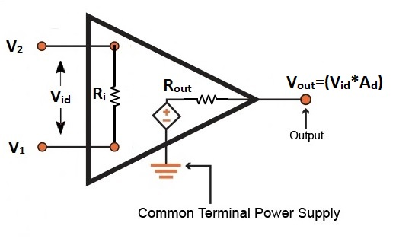
Practical OpAmp - Equivalent Circuit

